Slide 1
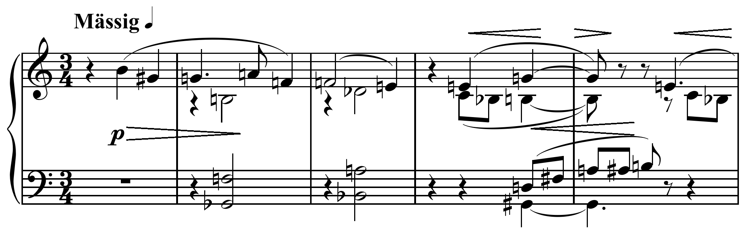
Chapter 3: Introduction to Triads and Seventh Chords
MUS 112
January 29 - February 2, 2017

Slide 2
Introduction
Chords are the basic vocabulary of tonal harmony

Slide 3
Triads
We will be building chords by stacking 3rds
Because tonal harmony is tertian (meaning built of 3rds)
The fundamental tertian sonority is the triad.
Triad is a three note chord
Triads in tonal harmony consist of a 5th divided by a third note to create two stacked thirds.
There are four possible triads that can result from stacking major 3rds and/or minor 3rds.

Slide 4
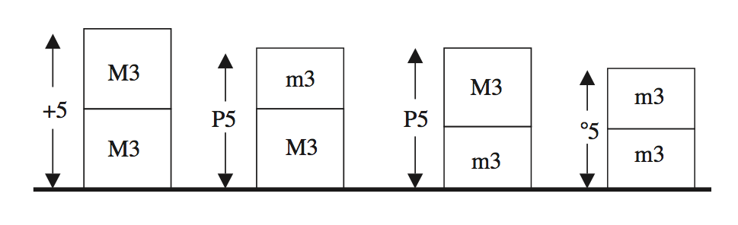
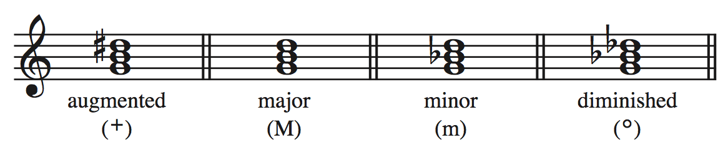
Each member of the triad has a name: the root, the third, or the fifth

Slide 5
Seventh Chords
Let’s extend a tertian triad by adding another 3rd on top of the 5th of the triad
We get a four-note chord.
chords of this sort are called seventh chords because the interval between this added note and the root is some kind of 7th.
Major, minor, diminished, or augmented
As you can imagine, there are many, many kinds of seventh chords. We will only need to know the five most common ones.

Slide 6
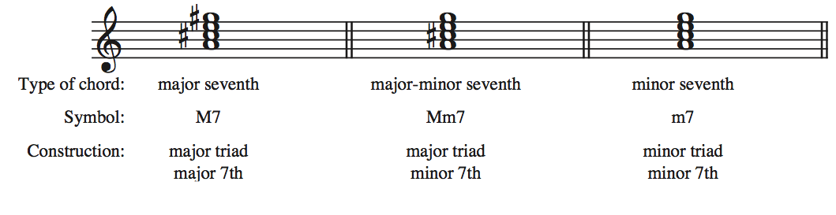
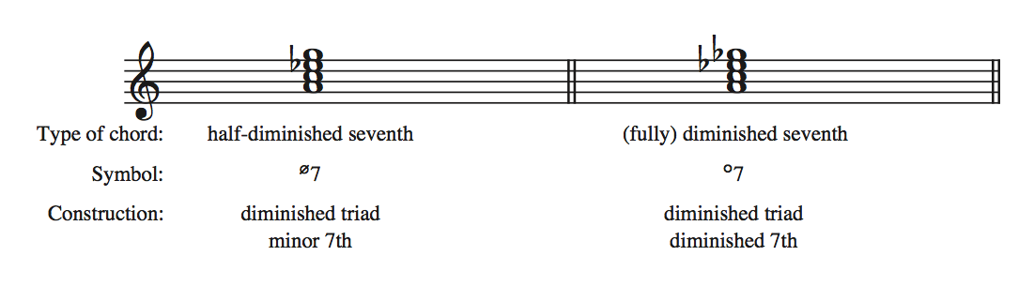

Slide 7
Quick note: We won’t be doing any writing or composing with seventh chords for quite awhile, so they won’t be referenced much in the text until Chapter 13
However, we will still need to know them for analyzing music.

Slide 8
Inversion of Chords
Up to now, we have been notating all chords with the root as the lowest tone.
However, any member of the chord can appear as the lowest
There are three bass positions:
Root position: the root is the lowest tone
First Inversion: the third is the lowest tone
Second Inversion: the fifth is the lowest tone

Slide 9
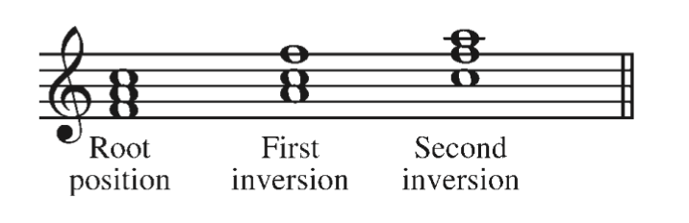
F major chord (all sorts of ways)

Slide 10
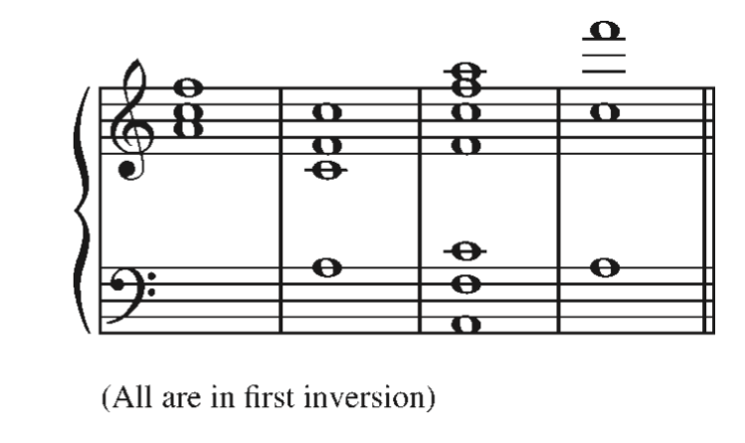
Doubling
Any notes of a triad can be duplicated, or doubled, in different octaves
F major:

Slide 11
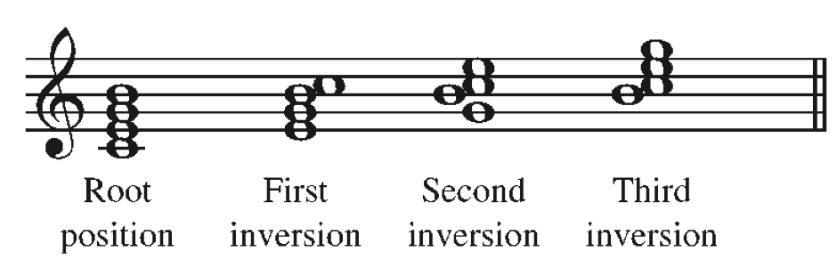
Inversion of Seventh Chords
Since there is an additional note in seventh chords, there is an additional inversion.

Slide 12
Figured Bass
Figured Bass: as system derived in the Baroque era (ca. 1600-1750) to allow a keyboard player to realize chords from a single note base line.
The player would receive a part with a bass line and symbols by the notes that would indicate which harmonies to improvise over the bass line.
It was also the responsibility of the player to fit in stylistically.
The symbols basically show which intervals over the bass to play.
We have adapted this system to show the bass position of chords.

Slide 13
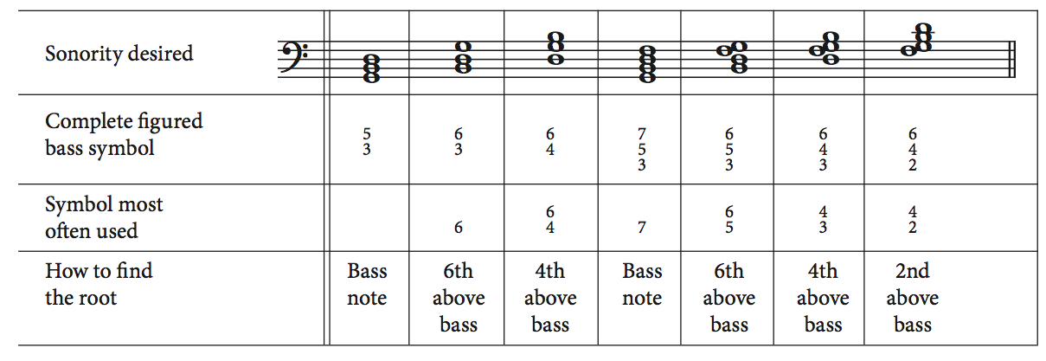
Figured Bass for a G Mm 7
This will be combined with Roman Numerals in Chapter 4

Slide 14
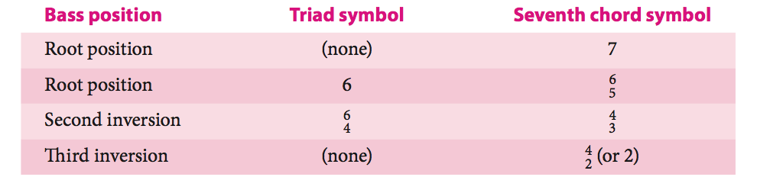

Slide 15

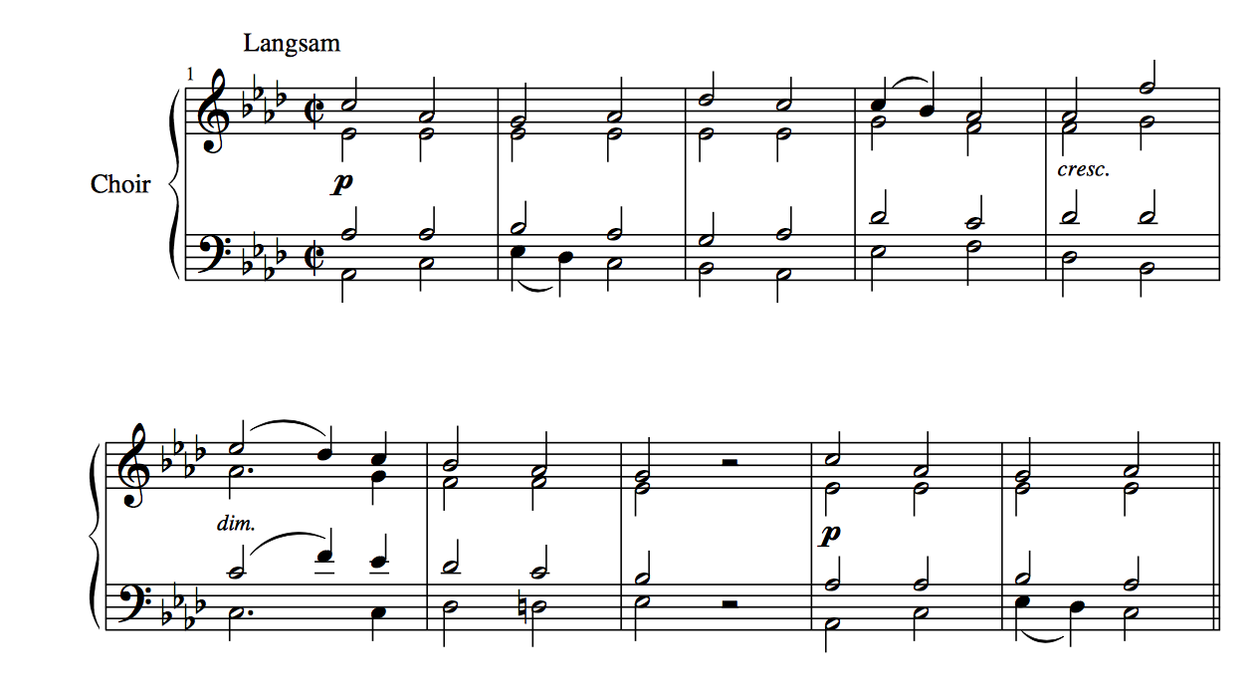
Bruckner: Tantum Ergo no. 4

Slide 16
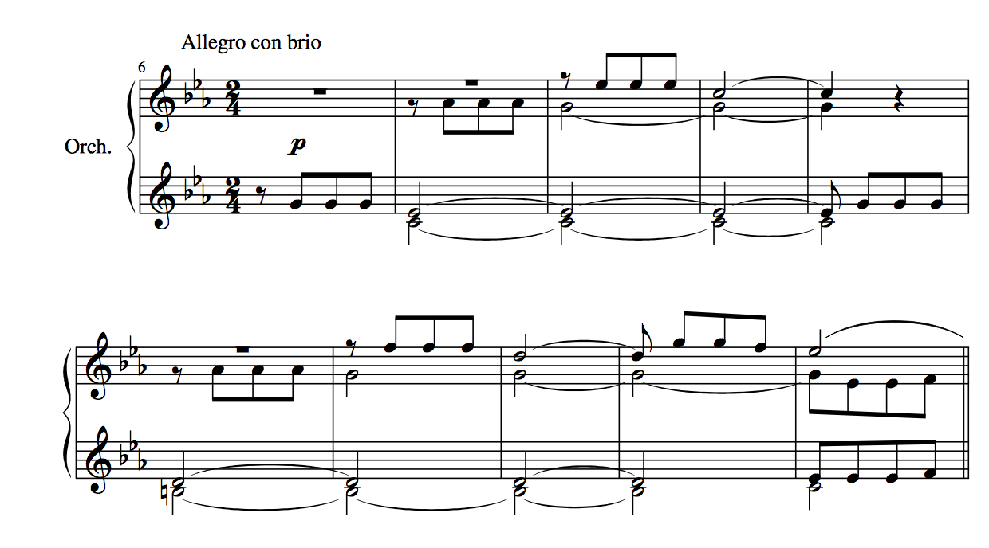
Beethoven, Symphony no. 5 in c minor, op. 67, mvt. 1, mm. 6-15

Slide 17
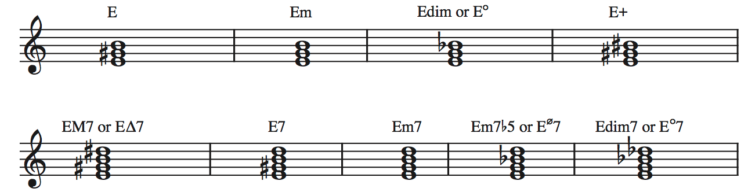
Lead Sheet Symbols
There are nine basic lead-sheet symbols you need to know
Triads:
Major, minor, diminished, augmented
Seventh Chords:
Major 7th, Major-minor 7th (dominant), minor 7th, half-diminished 7th, (fully) diminished 7th.

Slide 18
Lead Sheet Symbols & Inversions
To indicated an inversion with a lead sheet symbols, we write the lowest sounding note under the chord symbol (if it is not the root)
For example, an Em chord with a G in the bass is in what inversion?
1st Inversion
So we would write Em/G

Slide 19
